Slide 1


MAVERICKS
Track: Open Innovation
Problem Statement: India's farmers battle silent crises-from rooting crops to rigged markets without real time , voice-first help in their language
Project Title: Project Kisan-An AI Powered Personal Assistant for Indian Farmers
Team Name: MAVERICKS
College/Institute: MITS Gwalior & University of Science and Technology, Meghalaya
Team Leader: Ibrahim Laskar | ibrahimlaskar546@gmail.com | 6000425378

Slide 2
THEME & PROBLEM STATEMENT
Theme:
Empowering Small Farmers in Rural India with Expert Help, On Demand
Problem Statement:
Unpredictable crop diseases (diagnosis delays risk entire harvests)
Volatile market prices (timing sales is guesswork)
Limited digital literacy and resources
Information is scattered, complex, and not available in local languages
There’s no easy way for a farmer to get timely, trusted, actionable advice in their local language.
🔹​
🔹
🔹
🔹

Slide 3
PROPOSED SOLUTION
What it is: A smart, AI-powered assistant for small farmers, available via mobile and web, designed to solve two pressing needs:
🔹Crop Health Guidance: Instantly diagnose plant diseases and get actionable remedies by simply taking a photo or describing the problem in your native language.
🔹Market Intelligence: Ask about today’s crop prices, get trend analysis, and receive advice on when and where to sell for the best returns.
How it works:
🔹Easy Interaction: Farmers can speak, type, or snap photos using their phone. No need to be literate or tech-savvy.
🔹Local Language Support: The assistant understands and responds in Kannada (or other regional languages), breaking language and literacy barriers.
🔹Instant, Actionable Answers: Instead of raw data, farmers get clear step-by-step advice they can trust and act on.
🔹Powered by Google AI: Uses advanced image and language models (Gemini), plus real-time voice tech for seamless experience.
🔹Deployed via Firebase Studio: Fast, reliable, and scalable deployment for both web and mobile users.

Slide 4
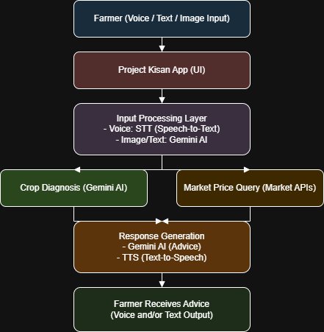
FLOWCHART

Slide 5
HOW IT WORKS
Disease Diagnosis Workflow
🔹Farmer takes a photo of a diseased plant and records a voice question.
🔹Voice is transcribed to text; photo and question sent to Gemini model.
🔹Gemini analyzes the image and text, identifies the disease or pest, and finds the best local remedy.
🔹The assistant replies in Kannada (voice and text): “This is early blight. Buy XYZ spray from your nearest agri shop and apply as shown.”
Market Price and Selling Advice Workflow
🔹Farmer asks, “What’s the price of tomatoes today in Chikkaballapur?”
🔹App transcribes question and fetches latest prices from official APIs.
🔹Gemini analyzes trends: “Prices rising for 3 days; sell tomorrow for better rates.”
🔹Advice is delivered as a voice note and on-screen summary.
Voice-First, User-Friendly
🔹All steps are possible without reading or typing.
🔹The assistant guides the farmer through the process with voice prompts and confirmations.
🔹Clear, actionable answers are always provided—never just raw data.

Slide 6
TECH STACK
Frontend:
🔹HTML, CSS, JavaScript — for building responsive web and mobile user interfaces (voice, text, image input)
Voice Processing:
🔹Vertex AI Speech-to-Text for understanding farmer queries in Kannada and other Indian languages
🔹Vertex AI Text-to-Speech for delivering responses in local languages
AI/ML Intelligence:
🔹Vertex AI Gemini (Multimodal):
Image & text analysis for crop disease diagnosis
Natural language understanding for market queries
🔹Vertex AI Agent Builder: Orchestrates user flows and AI responses
Data Integration:
🔹 Public Market Price APIs: (e.g., Agmarknet, eNAM) for real-time crop prices and trends
Backend & Hosting:
🔹Firebase Functions: To process requests and connect to AI/market APIs
🔹Firebase Hosting: Fast, secure web and mobile app deployment
Scalability & Analytics:
🔹 Firestore / Realtime Database: For user data, feedback, and analytics

Slide 7
FEATURES AND NOVELTY
Key Features
🔹Instant Disease Diagnosis: Snap a plant photo, get immediate diagnosis and remedy.
🔹Real-Time Market Advice: Voice/text queries give today’s prices, trend analysis, and selling tips.
🔹Voice-First, Local Language: Full support for Kannada and other Indian languages; easy for all literacy levels.
🔹Actionable Guidance: Simple, step-by-step advice—never just raw data.
🔹Fast & Scalable: Built on Firebase Studio and Google AI for reliability and quick updates.
Novelty
🔹First to merge voice, image, and market tools for Indian farmers, all in their language.
🔹Truly accessible: Designed for real-world use by small farmers, not just tech-savvy users.
🔹End-to-end Google AI integration for best accuracy and user experience.

Slide 8
DRAWBACK AND SHOWSTOPPERS
Drawbacks
AI Limitations: May misdiagnose rare or new crop diseases, especially from unclear or poor-quality photos.
Data Gaps: Market price APIs can be outdated or unavailable, reducing advice accuracy.
Connectivity Issues: Needs stable internet—may not work reliably in remote or low-network areas.
Adoption Barriers: Some farmers may still hesitate to trust AI or use new technology.
Show Stopper
If the AI frequently misdiagnoses diseases or real-time market data is unavailable, farmers may lose trust, undermining the solution.

Slide 9
Team Details
Team Name: MAVERICKS College: MITS Gwalior (AI & DS) + USTM Meghalaya (CSE + AI)
TEAM NAME
Team Leader: Ibrahim Laskar
Branch: CSE, USTM
ibrahimlaskar546@gmail.com | 6000425378
Team Members:
Najeeb Farhan Mazumder Branch: AI , USTM najeebmazumdar@gmail.com | 9954146005
Khushi Rawat Branch: AI & DS, MITS Gwalior khushirawatttt@gmail.com | 9617625434
Sanjana Sanodiya Branch: AI & DS, MITS Gwalior sananasanodiya860@gmail.com | 9893085487

Slide 10
THANK YOU

